Slide 1


GRIEVAI: DECENTRALIZED AI-POWERED GRIEVANCE REDRESSAL
TEAM – [DOIT]

Slide 2

PROBLEM STATEMENT
This results in a disconnection between citizens and local government, making it imperative to adopt innovative solutions for better engagement and responsiveness.
The lack of real-time insights hinders authorities from effectively addressing issues, reducing accountability and transparency in governance.
Manual civic complaint redressal processes are often inefficient and slow, leading to frustration among citizens seeking timely resolutions.

Slide 3
THE GAP
The absence of urgency-based routing results in delayed responses, leaving critical issues unresolved and communities increasingly dissatisfied with service delivery.
Many civic complaints remain unaddressed due to the lack of an efficient and centralized platform for reporting and tracking issues.
Without a real-time feedback loop, citizens feel disconnected from local governance, leading to frustration and a lack of engagement.

Slide 4
OUR SOLUTION
The integration with Supabase provides a robust infrastructure for data storage and management, enhancing user experience and reliability.
GrievAI leverages real-time data by fetching tweets related to civic issues, ensuring immediate attention and action.
Using advanced AI classification, we categorize complaints effectively, allowing for quick routing and resolution by moderators.

Slide 5
KEY FEATURES
Our solution utilizes AI classification to intelligently sort civic complaints, enhancing the efficiency of processing and response times for users.
The moderator panel allows for seamless interaction, ensuring complaints are validated and prioritized based on urgency and community needs.
With real-time analytics and SMS notifications, users stay informed about their complaints, fostering a sense of engagement and trust in the system.

Slide 6

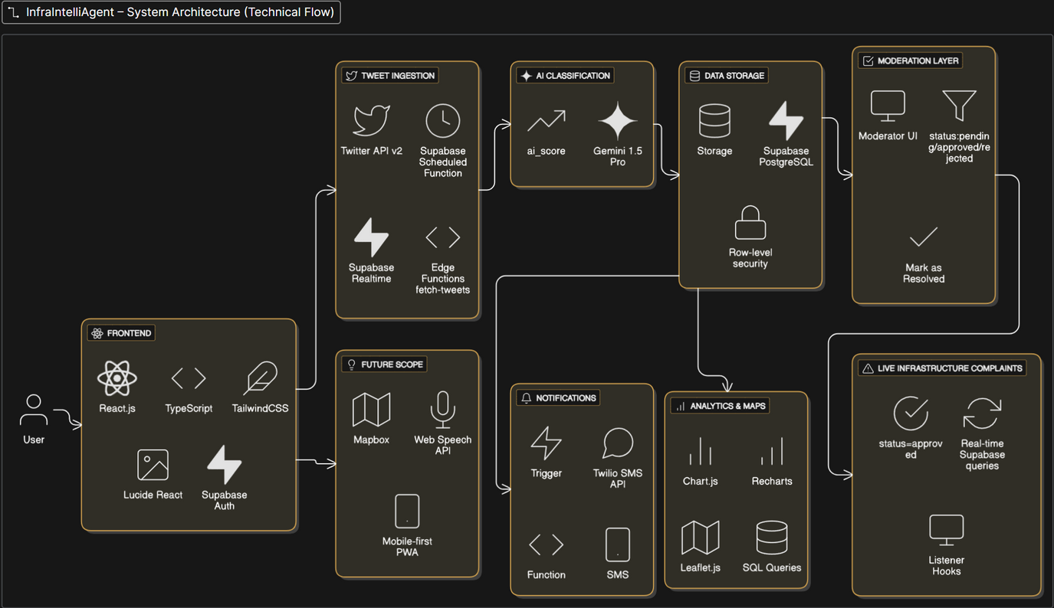
SYSTEM ARCHITECTURE OVERVIEW

Slide 7
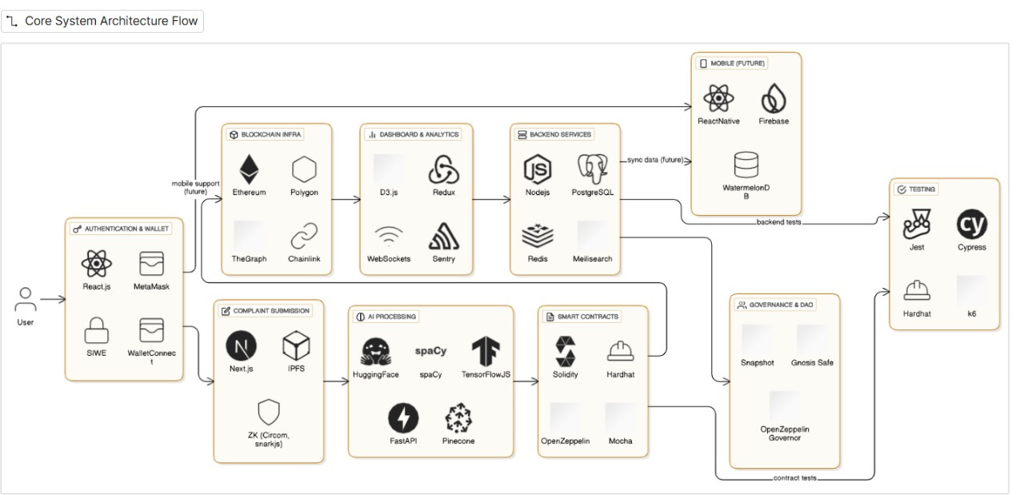
SYSTEM ARCHITECTURE OVERVIEW

Slide 8
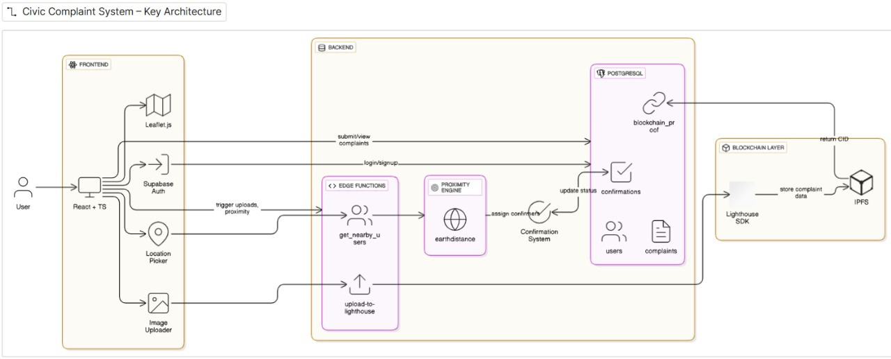
SYSTEM ARCHITECTURE OVERVIEW

Slide 9

TECH STACK OVERVIEW
WALLET CONNECTION | METAMASK, WALLETCONNECT, ETHERS.JS
COMPLAINT SUBMISSION | REACT, TAILWINDCSS, IPFS, ZOD, FORMIK
AI PROCESSING | HUGGING FACE, TENSORFLOW.JS
SMART CONTRACT LAYER | SOLIDITY, HARDHAT, FOUNDRY, OPENZEPPELIN
GOVERNANCE | SNAPSHOT, OPENZEPPELIN GOVERNOR,
ANALYTICS & DASHBOARD | RECHARTS, REDUX, WEBSOCKET, SENTRY
STORAGE & INDEXING | IPFS/WEB3.STORAGE, CERAMIC, THE GRAPH
DEPLOYMENT | GITHUB ACTIONS, VERCEL

Slide 10
UI SHOWCASE
The Map View visually represents complaints, while the Approval Feed and SMS Logs streamline communication and tracking of issues reported.
The AI Score indicates the relevance and urgency of each complaint, ensuring prioritization for effective responses from moderators.
Our platform features auto-fetched tweets that provide insights into real-time civic complaints directly from social media.

Slide 11
USE CASES
Infrastructure complaints are streamlined through our dashboard, enabling faster resolutions and promoting trust between citizens and civic bodies with transparent processes.
Our platform effectively addresses garbage collection issues by allowing citizens to report problems via tweets, enhancing response times significantly.
By monitoring flooding alerts, GrievAI provides real-time insights to local authorities, ensuring timely interventions and improved community safety.

Slide 12
ROADMAP
Integrating voice input will enhance user experience by allowing hands-free interaction, making it easier to report grievances efficiently.
Implementing Mapbox clustering will improve visibility of complaints, allowing users to navigate issues in their locality more effectively.
Introducing AI moderation and role-based access will ensure a secure and streamlined process for managing complaints and user interactions.

Slide 13
REAL-WORLD IMPACT
The platform's easy integration with existing systems allows seamless adoption, ensuring that stakeholders can leverage its benefits without disruption.
Faster surfacing of complaints enables timely responses, enhancing community engagement and ensuring that issues are addressed promptly.
By providing verified complaints, trust between citizens and authorities is strengthened, leading to increased participation in civic processes.

Slide 14
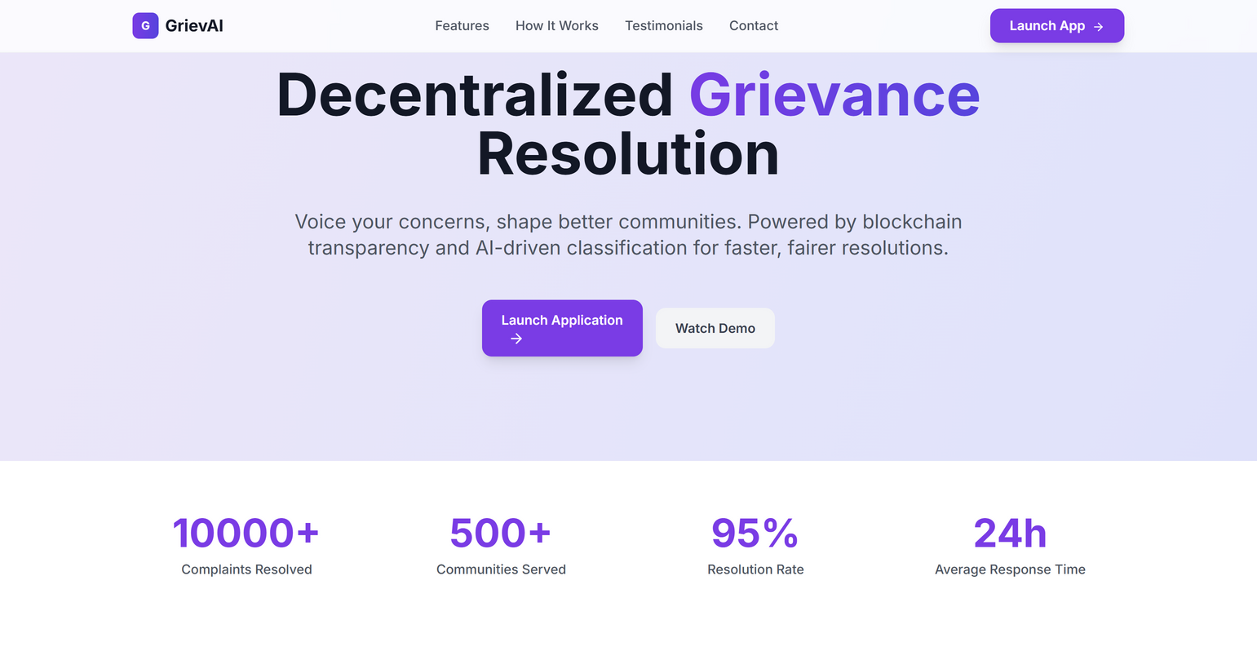
SCREENSHOTS

Slide 15
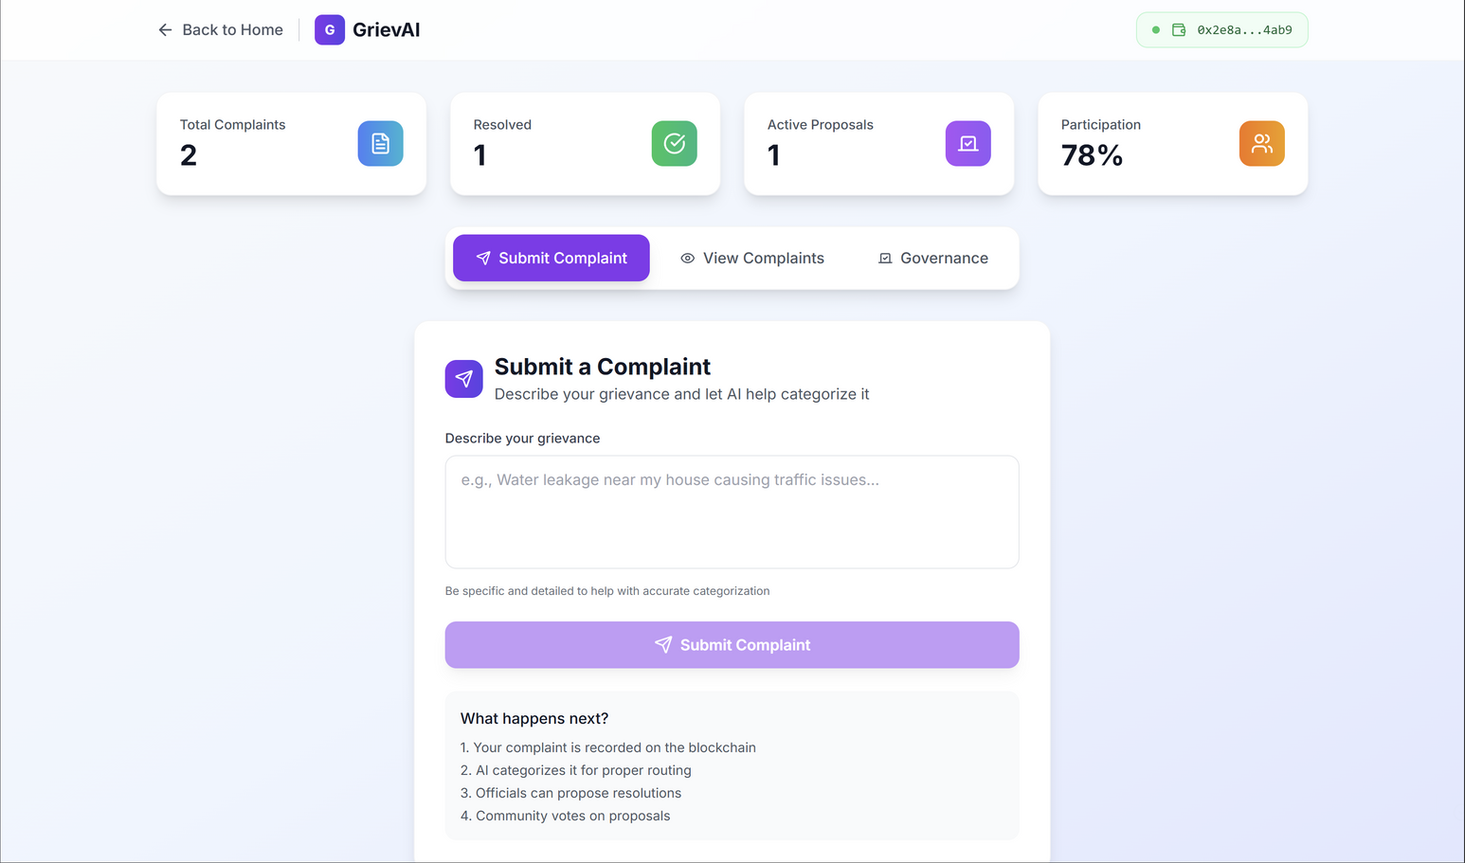
SCREENSHOTS

Slide 16
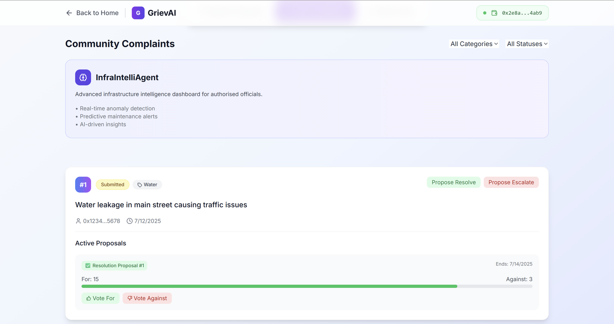
SCREENSHOTS

Slide 17
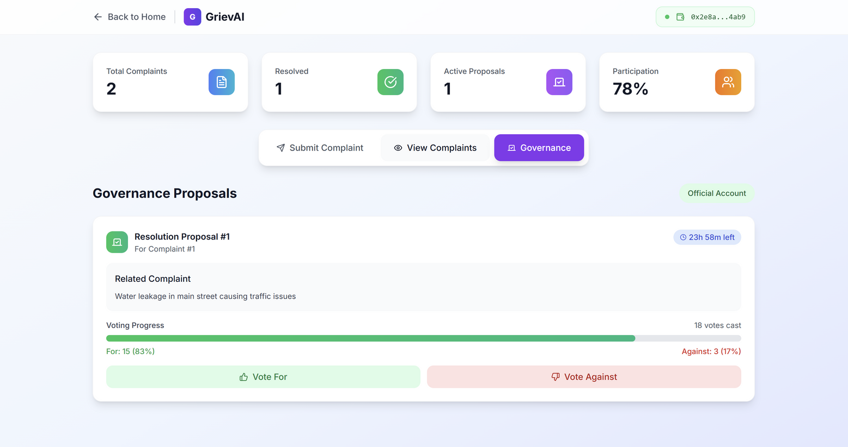
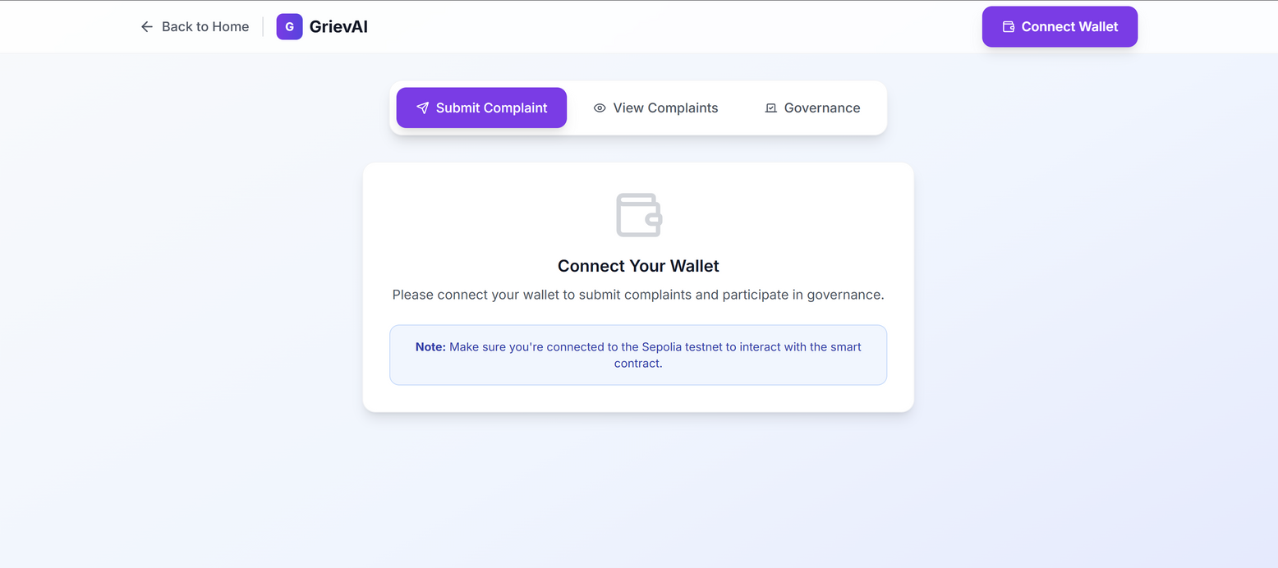
SCREENSHOTS

Slide 18
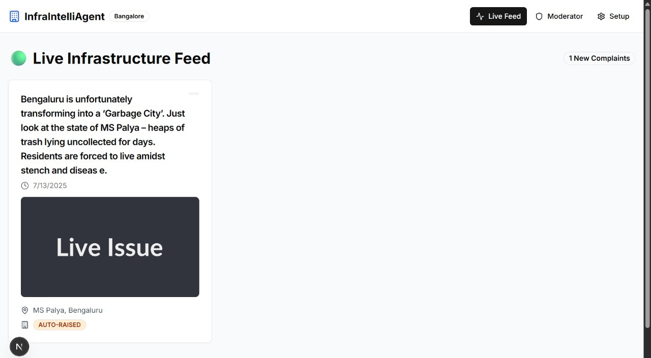
SCREENSHOTS

Slide 19
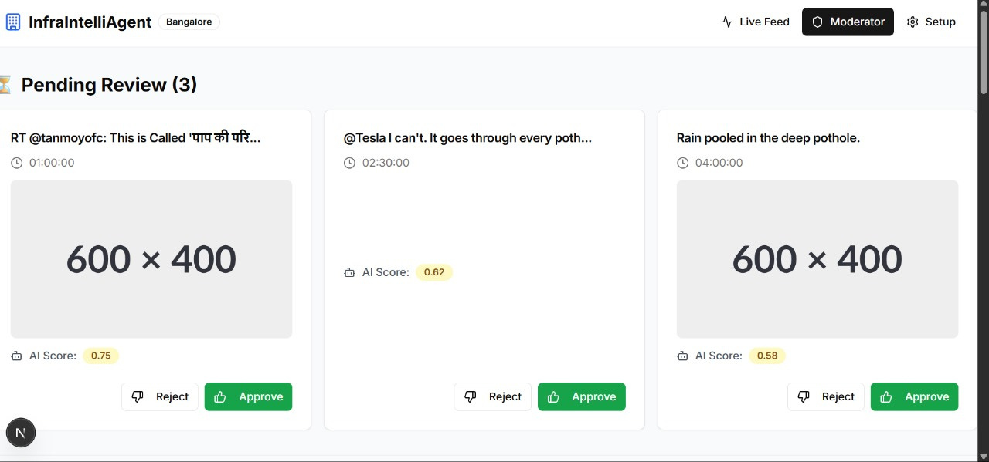
SCREENSHOTS

Slide 20
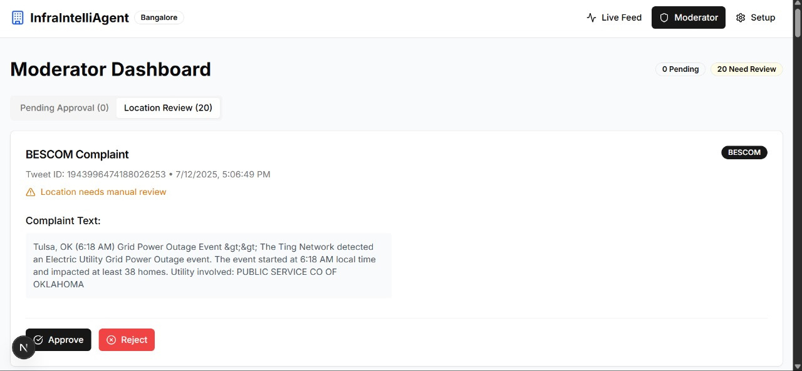
SCREENSHOTS

Slide 21
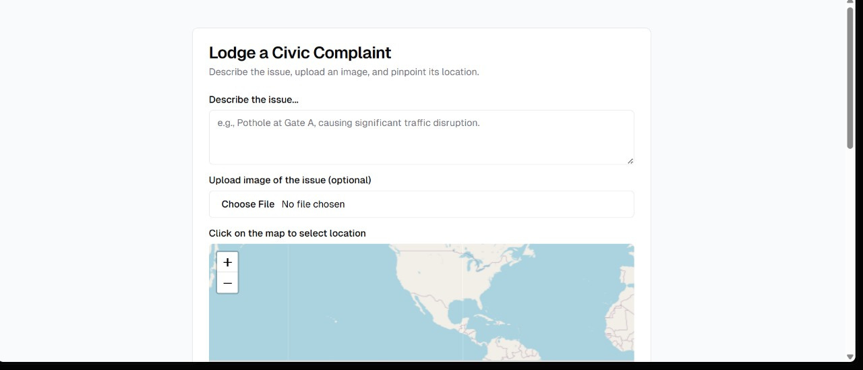
SCREENSHOTS

Slide 22
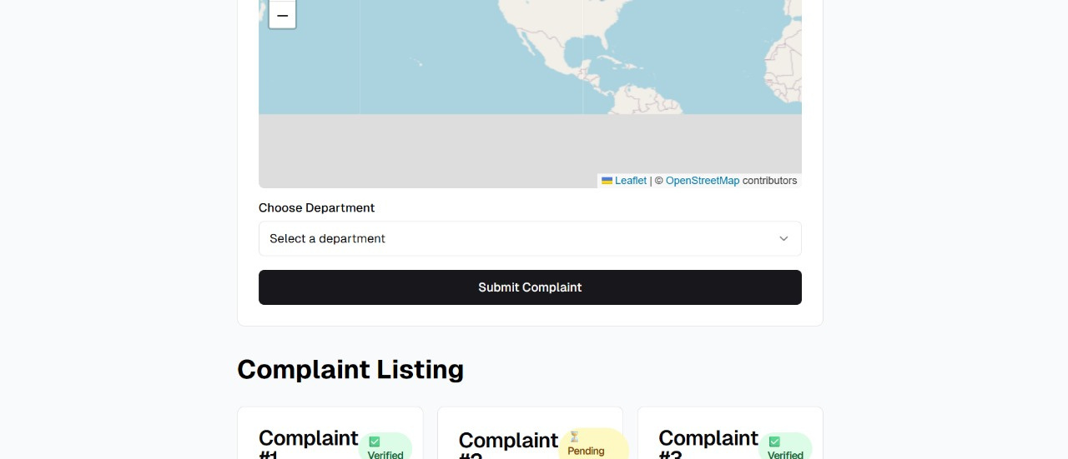
SCREENSHOTS

Slide 23

BUILT WITH LOVE, CODE, AND A DASH OF DECENTRALIZATION

